Slide 1
Nonprofit Ethical Case:
Growth at a human price: How Silicon Valley Community Foundation’s leaders fostered a toxic culture
Brittany Jones, Lily Kimbel, Zoe Rudman
NPA 601: NONPROFIT ETHICAL LEADERSHIP
Spring 2020
Prof. Marco Tavanti. Ph.D

Slide 2
Overview
Background
Case Study
News Reports
Facts and Timeline
Compliance
Responsibility
Individual
Organizational
Systemic
Stakeholder Analysis
Alternative Solutions
Discussion

Slide 3
Background
Silicon Valley Community Foundation founded in 2007 with Emmett Carson at the helm
Defined itself as the “largest community foundation in the world”
Manages philanthropy for clients through Donor Advised Funds
$13.5 billion in assets
Given over $6 billion in grants worldwide since 2007, 50% within the Bay Area
Silicon Valley success story
Courage - Collaboration - Inclusion - Respect - Accountability
Notes:
LK Notes
Once upon a time, there was a mommy foundation and a daddy foundation, and they loved each other very much. So they merged and created a baby, the Silicon Valley Community Foundation, born in 2007.

Slide 4
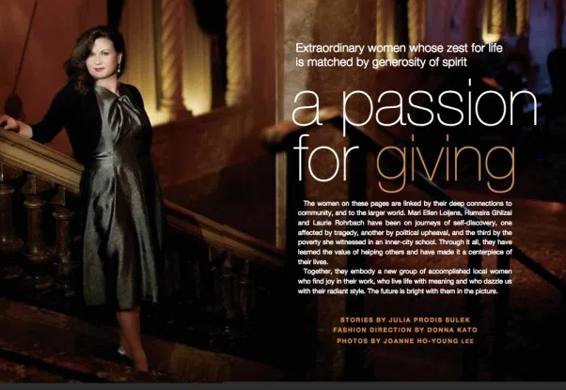
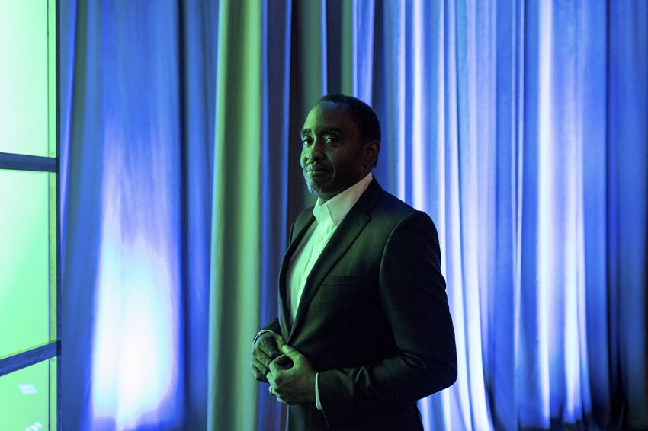
Case Study in Unethical Leadership
Culture of Growth over Mission
Mari Ellen Loijens, Chief Business,
Development and Brand Officer
High performer
Emotionally abusive
Sexual harassment, threats
Oppressive management
Minimal response from HR
Investigation began after The Chronicle of Philanthropy presented Emmett Carson, SVCF's high-profile, charismatic CEO, with allegations against Loijens
Notes:
Image sources (l-r): Scene Magazine, New York Times
LK Notes

Slide 5
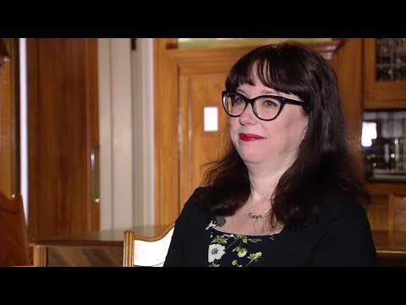
In the News
ABC7 News Bay Area: Silicon Valley Community Foundation CEO on paid leave
A former employee of SVCF shares her experience working under Mari Ellen Loijens, an experience that eventually caused her to resign. She believes SVCF should hold Emmett Carson more accountable for what took place within SVCF.
Notes:
LK Notes https://www.youtube.com/watch?v=o4GtCXwfCok

Slide 6
Facts
2006
2007
2011
April 18, 2018
SVCF is Created
Emmett Carson, CEO
$1 billion dollars raised
The Chronicle of Philanthropy publishes report
SVCF is created as a merger of the Peninsula Community Foundation and the Community Foundation of Silicon Valley
Mari Ellen Loijens comes on as his second in command after serving as Director of Development for SVCF parent organization since 2004
SVCF has raised over $1 billion in funds to be dispersed in grants from its opening in 2007
The Chronicle publishes an expose on SVCF based on staff accounts of workplace culture
“Muskrat”
Term coined by employees to let Loijens know she had crossed the line
“She thought it was funny”
January 1, 2016 - April 18, 2018
73 out of 104 employees left
Notes:
Muskrat photo - Getty Images/iStockphoto

Slide 7
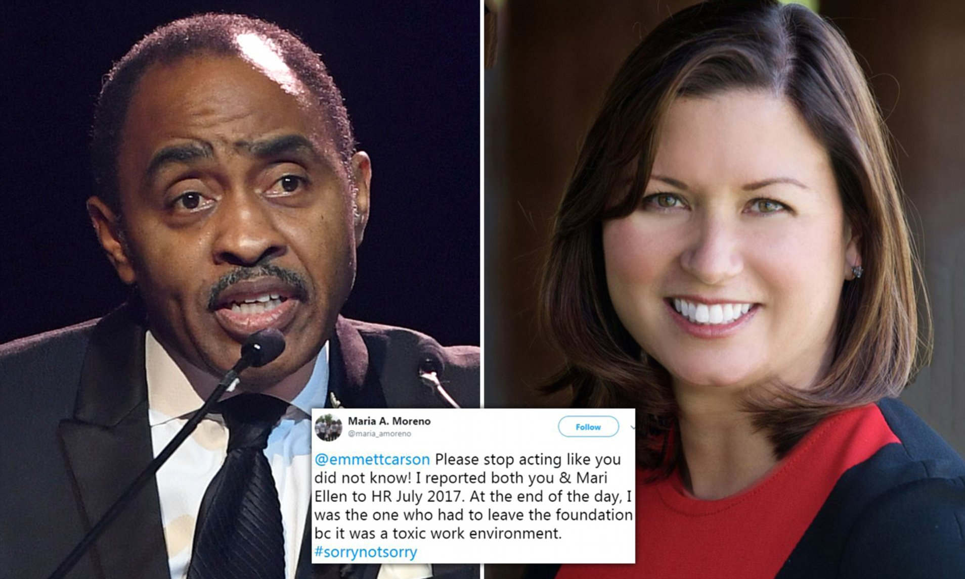
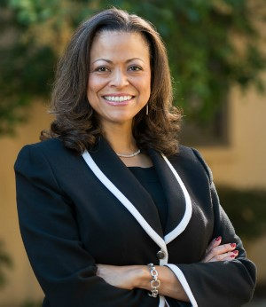
Facts
April 19, 2018
April 24, 2018
April 26, 2018
June 27, 2018
Investigation is published
Emmett Carson resigns
Mari Ellen Loijens resigns
Emmett Carson placed on paid leave
The Board of SVCF hires Boies Schiller
Mari Ellen Loijens resigns one day after the Chronicle article is published
Boies Schiller is hired to investigate the allegations. Infamous for his representation of Harvey Weinstein
The Board of SVCF publishes Public Report on Workplace Investigation from their legal counsel’s investigation
Emmett Carson resigns after 11 years of service in conjunction with the Board publishing the investigation’s findings
November 2018
Nicole Taylor named new CEO of SVCF
Notes:
Tweet Picture: Daily Mail UK
Nicole Pic: Linda Cicero, Stanford University

Slide 8
Compliance
SVCF’s human resources department failed in their responsibilities to the organization and to the staff
Staff did not feel comfortable going to HR for fear of retaliation
According to SVCF’s 2017 990 form, they did have an existing whistleblower policy, but was it enforced?
Mari Ellen Loijens’ behavior and Emmett Carson’s lack of response created a hostile work environment for staff
Loijens’ comments and pattern of behavior over years could qualify as workplace harassment under California law
Notes:
Behind the ethical issues, are there some legal and compliance issues in this case? Please explain in bullet points.
Photo source: screenshot of SVCF’s 2017 990 and https://resources.workable.com/stories-and-insights/hostile-work-environment-signs-fixes

Slide 9
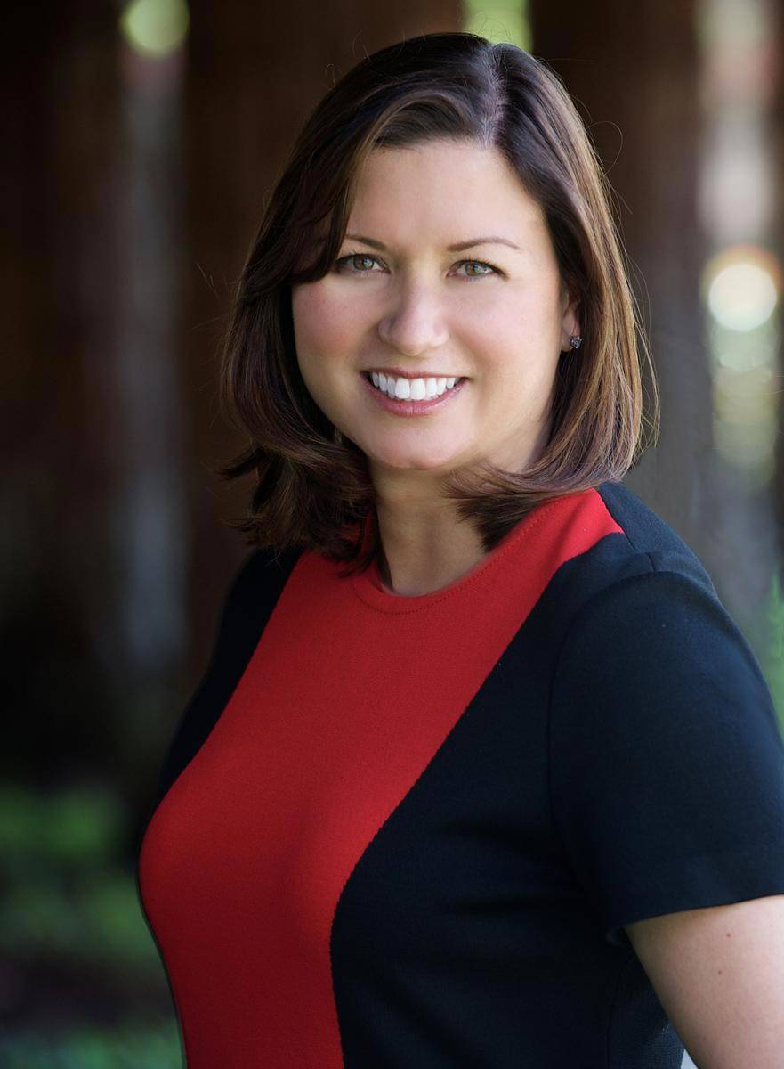
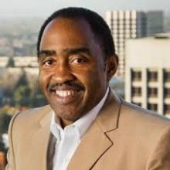
Individual Responsibility
Mari Ellen Loijens
Responsible for her own behavior and how she treated employees
Demonstrated fear-based leadership
Used her success as a fundraiser to get away with her actions
Emmett Carson
As the CEO, the buck stops with him. Turned a blind eye to internal issues and ignored multiple staff complaints
The Board - arguing they had no idea it was going on - that alone is an issue even if true, that they should have known about a toxic culture that was in place for years
HR staff at SVCF
Brushed off repeated complaints or did not take serious action to limit harm to employees
Notes:
Begin your ethical leadership (organizational) analysis by considering the ethical irresponsibility of the individuals involved in this case.
Mari Ellen Loijens image: https://www.kqed.org/arts/13829974/top-fundraiser-at-silicon-valley-community-foundation-resigns
Emmett Carson image: https://www.concordia.net/community/emmett-carson/

Slide 10
Organizational Responsibility
The human resources department within SVCF should have listened to and protected its employees from abuse, and created an environment in which employees felt safe to report wrongdoing without fear of retaliation
SVCF had an organizational responsibility to uphold its values of courage, collaboration, inclusion, respect, and accountability
Notes:
Are there any elements that pertain to the collective / organizational level of responsibilities that would have prevented, corrected, or detected the ethical issue?
Image source: https://iaonline.theiia.org/2018/Pages/Protecting-Employees.aspx

Slide 11
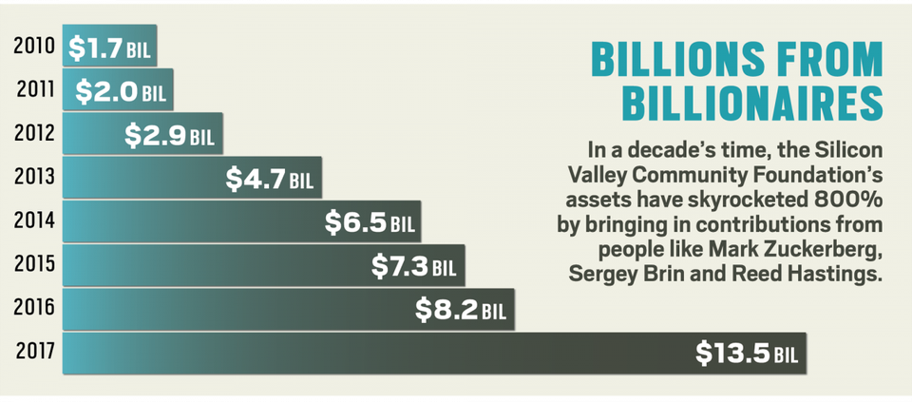
Systemic Responsibility
The nonprofit sector should view its workforce as an asset and, thus, protect those assets with the same level of responsibility as they would financial assets
The existence of whistleblower policies does not mean they are enforced
While foundations are
nonprofits, their proximity to
power and resources can
corrupt, and they may not see
themselves as accountable to
the communities they claim
to serve
Notes:
What are some of the issues that pertain to the institutional level of responsibilities? For example the culture of corruption, individual perceptions of entitlement, the system of financial accountability required in a specific administration.
Image source: https://www.forbes.com/sites/kerryadolan/2018/05/02/silicon-valley-community-foundation-emmett-carson/#7a4d221415f0

Slide 12
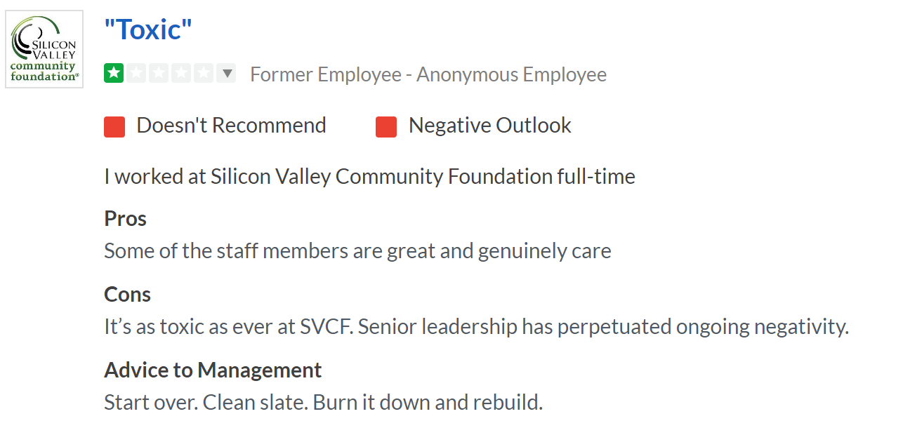
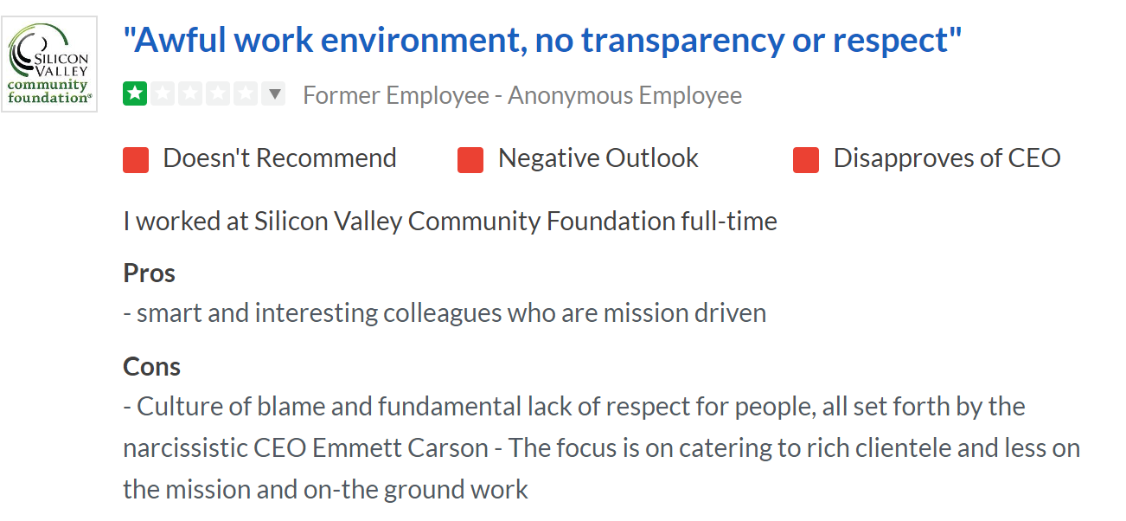
Stakeholder Analysis
Consequences of the SVCF’s toxic work culture:
Glassdoor Reviews and publicity surrounding the case create mistrust in the community and giving their money to SVCF
Rose McGowan decided not to open a donor-advised fund after being tipped to look at SVCF Glassdoor reviews.
Donors lost to publicity of the case
Former employees discouraging applicants from applying due to the culture
Current employees don’t trust SVCF to protect them and listen to them when reporting to HR
Furthering a culture of turnover
Notes:
Any organization going through what Silicon Valley Community Foundation has, will have effects on this big groups of stakeholders:
SVCF - the organization itself is a stakeholder affected by its actions
The community it serves
Reports of donors backing out
It’s future employees
cautious to apply
Current employees
feeling stuck in an “it is what it is” situation - causing turnover

Slide 13
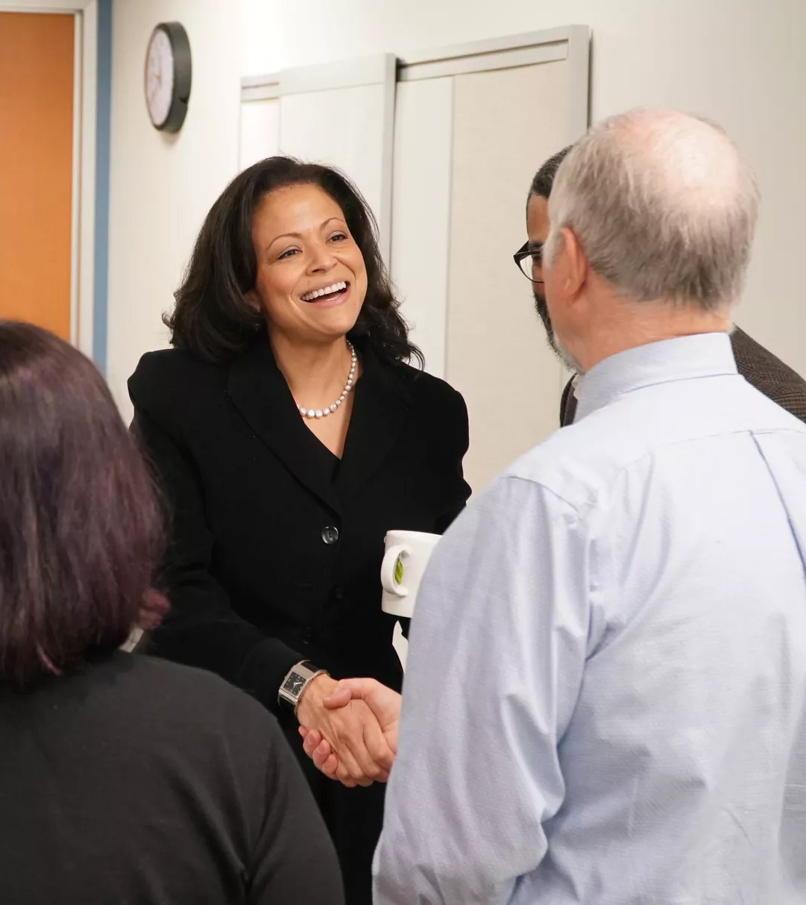
Alternative Solutions
Preventions & Remedies
Executive Leadership
Leadership on all levels (Board, CEO, C-Suite) - abolishing the fear of retaliation, willing to listen to reports and take necessary action. Prioritize the people over the $
Human Resources Department
Treat all staff equitable and fair
Action must be taken on reported misconduct and inappropriate behaviors
Prioritizing mission above all
Putting employees and mission before revenue and income would alleviate the culture of protecting staff like Loijens, responsible for bringing in big donations
“The goal isn’t going to be growth at all costs — or even really focusing on growing the assets…”
SOURCE: Vox
Notes:
3 big things that could have been done to prevent this issues
Executive leadership
it’s on them to foster the work culture and eliminate fears and create a space for employees to use their voices.
Something that could certainly have helped to prevent this situation was a Human Resources Department working the way it should - taking reports seriously, not being fearful of retaliation from executive leadership
they are expected to be the voice for employees and take action when needed
Remembering why we are here in the first place - who do we serve? why do we serve them?

Slide 14
Questions
How can leadership be made accountable for workplace culture?
What types of behaviors within an organization do you view as unethical but, perhaps, not illegal?
Should workplace culture within nonprofit organizations be held to a higher ethical standard, given the industry focus on mission and fiduciary responsibility?
Should internal issues affect external clients deciding to do business with the foundation, or not?
With new leadership in place, how does an organization regain the trust of both its staff and the broader community?
As an ethical leader, how would you have handled your most successful fundraiser being accused of these allegations?
When the executive leadership within an organization is so clearly failing, what responsibility does the board have to step in?
Notes:
LK Notes

Slide 15
References
Materials for other organizations to reference regarding this case study:
https://nonprofitrisk.org/resources/articles/the-dark-side-of-leadership/
https://www.councilofnonprofits.org/tools-resources/sexual-harassment-the-nonprofit-workplace
https://www.philanthropy.com/article/Opinion-Growth-or-Mission-/243383

