Slide 1
Bicycle-Sharing Systems
AKA: B.S.S.

Slide 2
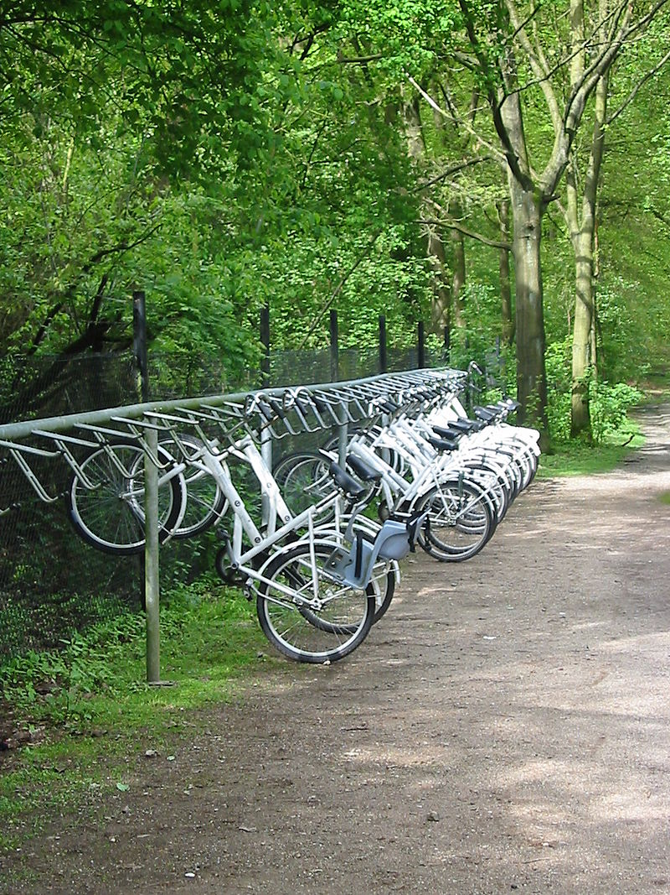
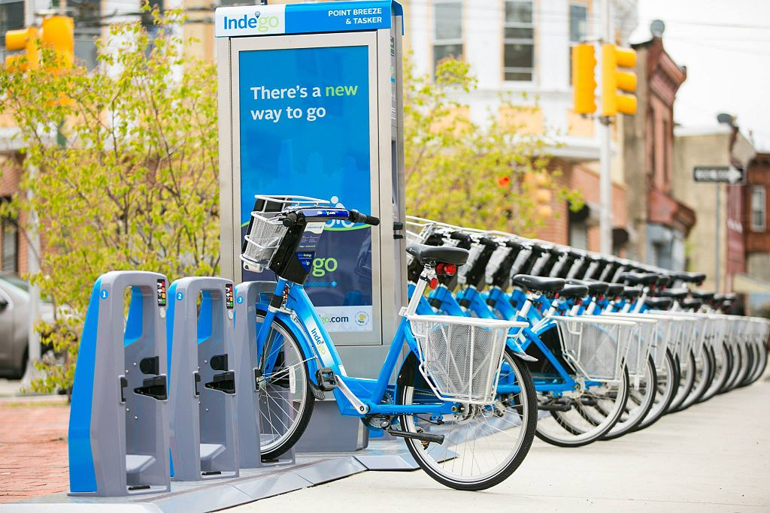
What is a BSS?

Slide 3
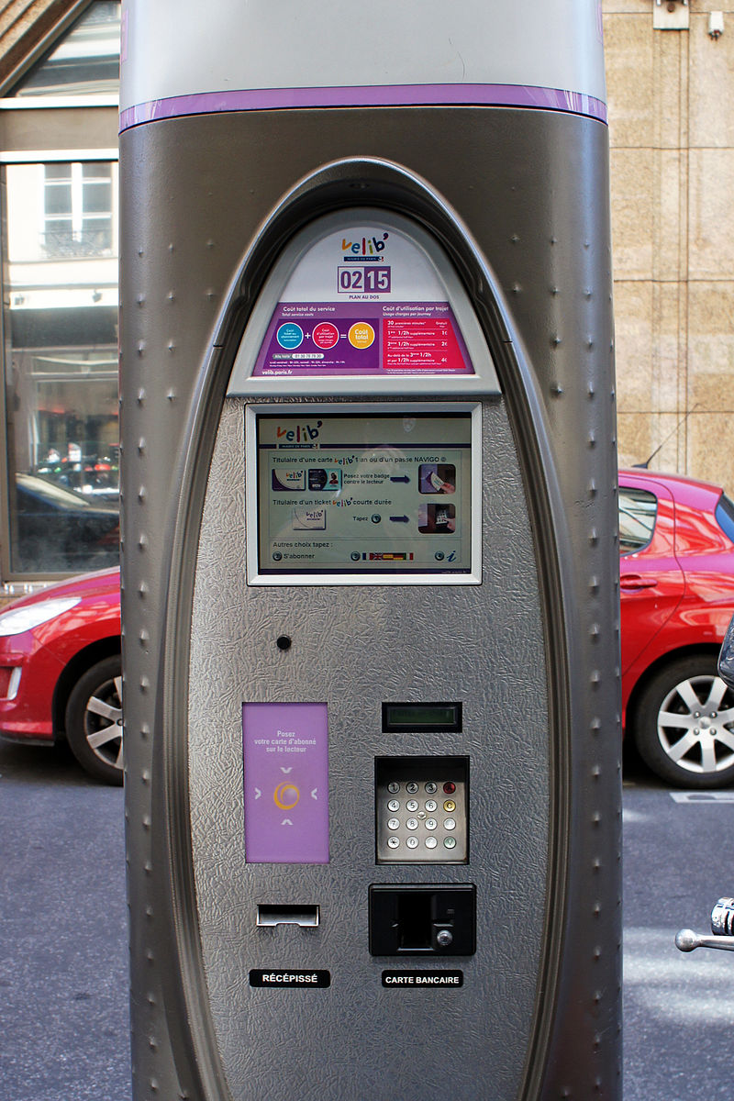
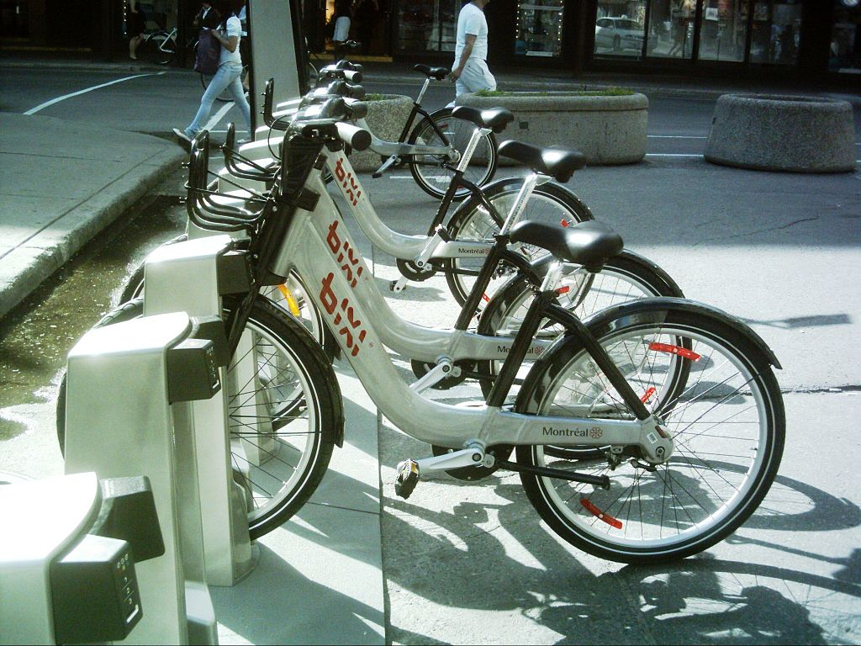
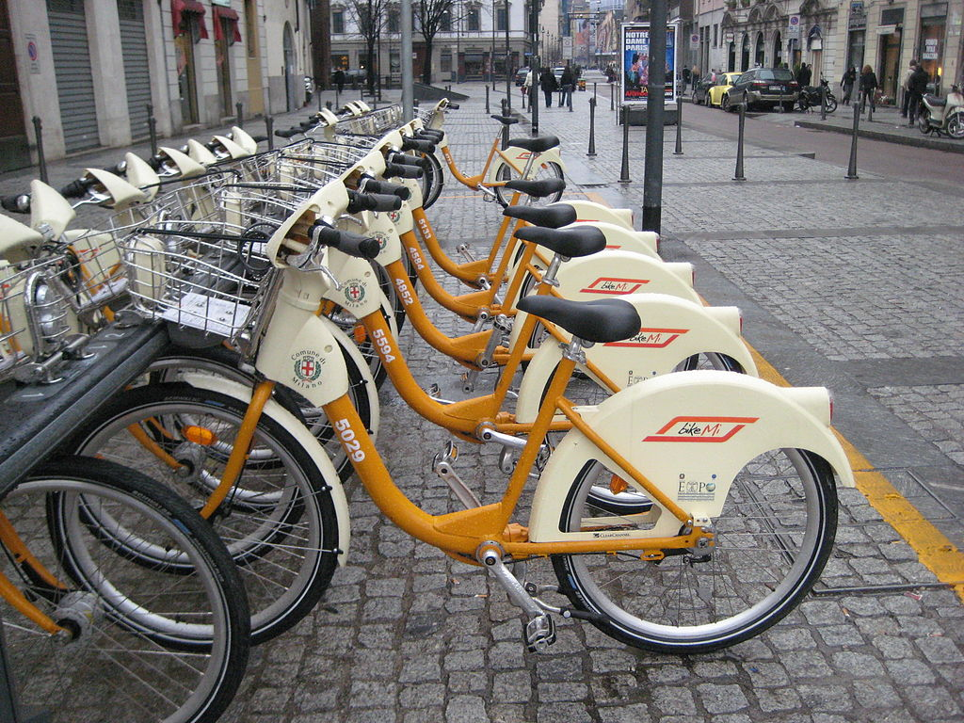
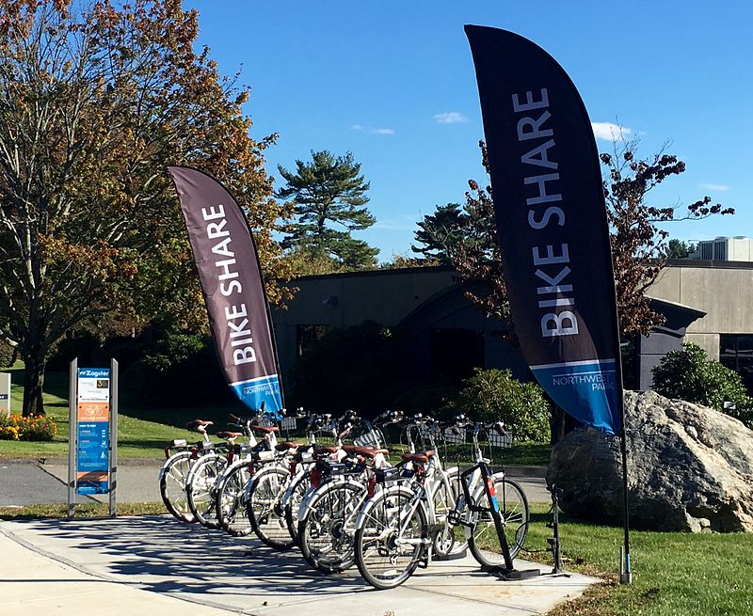

Slide 4
Goals of bss’s
To increase cycling levels, and help normalize and promote cycling;
To improve accessibility and support flexible mobility;
To reduce single occupancy car journeys and ease traffic congestion;
To improve road safety, in particular for cyclists;
To reduce CO2 emissions and to improve air quality by reducing other pollutant emissions from motorized traffic;
To improve public health and increase levels of physical activity;

Slide 5
Evidence on the impacts of bike-sharing
Determinants of and barriers to bike sharing use
Transport mode substitution
Broader changes in users’ travel behaviors
Impacts on attitudes to cyclists
Environmental impacts
Health impacts

Slide 6
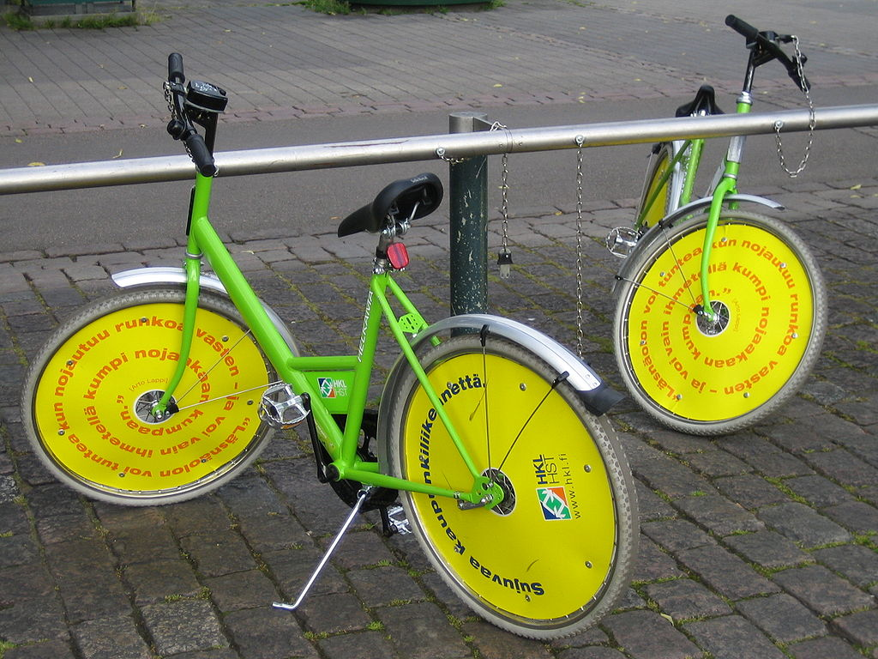
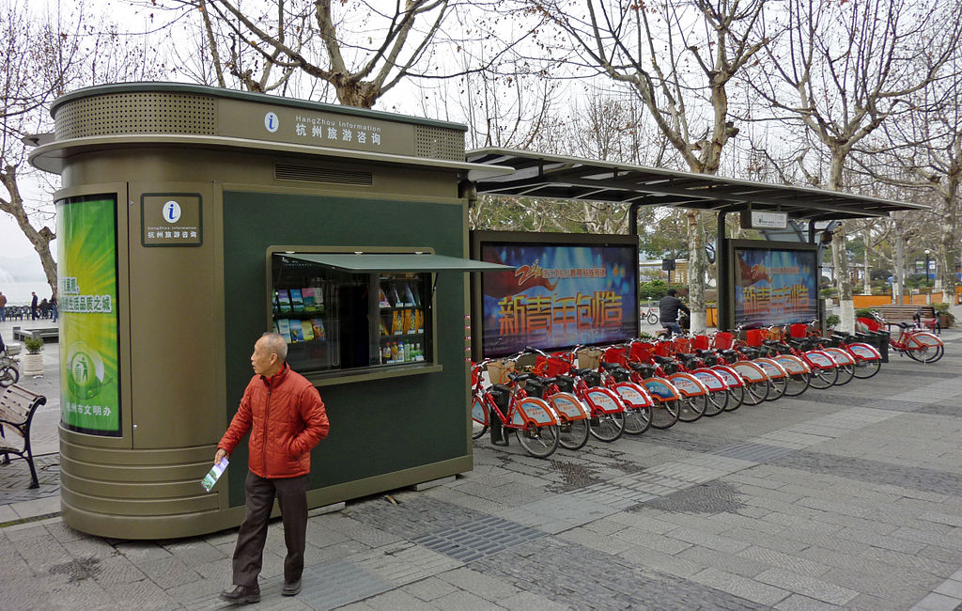
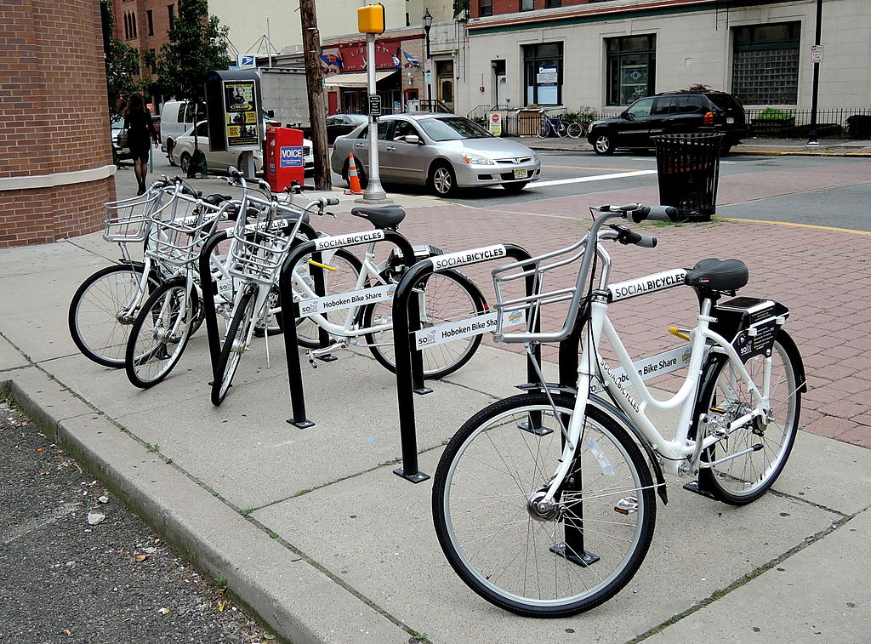

Slide 7
