Slide 1
Outlines and Topic Sentences
Njoud Almusallam
Selene Torres

Slide 2
What is the important part in the essay?

Slide 3
Definitions:
Outline:
A summary of a text or subject, usually presented in headings and subheadings.
Topic Sentences:
A sentence that expresses the essential idea of a paragraph or larger section, usually appearing at the beginning.

Slide 4
Outline:
All source material should be assessed on the basis of four criteria:
Relevance
Currency
Credibility
Objectivity
Guide your note taking
Organize the main points of your topic

Slide 5
Example:
Presentation of Rhetorical Analysis of the TED Talk Why the only future worth building includes everyone | Pope Francis
Outline
Who is Pope Francis?
Main Points of the TED Talk
Pathos
Logos
Ethos
Conclusion

Slide 6
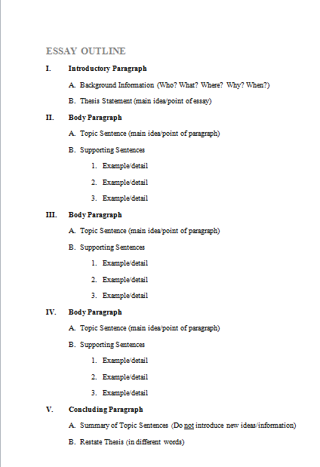
Example Essay Outline:

Slide 7
Topic Sentence:
Could not be a fact.
Is not a question.
So it include:
It give us a main idea of what the paragraph will talk about.
What he author is going to tell about the main idea. Controlling idea.
Subject+ controlling idea

Slide 8
Main idea
It could be broad.
Global Warming
Wealth
Halloween

Slide 9
Controlling Idea
It could be expressing an opinion.
Global Warming is effecting forest the most
Wealthy people are more educated
Number of death increases during Halloween

Slide 10
Examples:
Topic Sentence: Dogs make wonderful pets because they help you to live longer. The topic is "dogs make wonderful pets" and the controlling idea is "because they help you to live longer."
Topic Sentence: Teen pregnancy may be prevented by improved education. The topic is "teen pregnancy may be prevented" and the controlling idea is "improved education."

Slide 11
Questions
Where is the main idea and controlling Idea:
Having a first child is difficult because of the significant adjustments in your life.
Remodeling a kitchen successfully requires research and a good eye.
Write about:
Exercise or Workout

